Slide 1
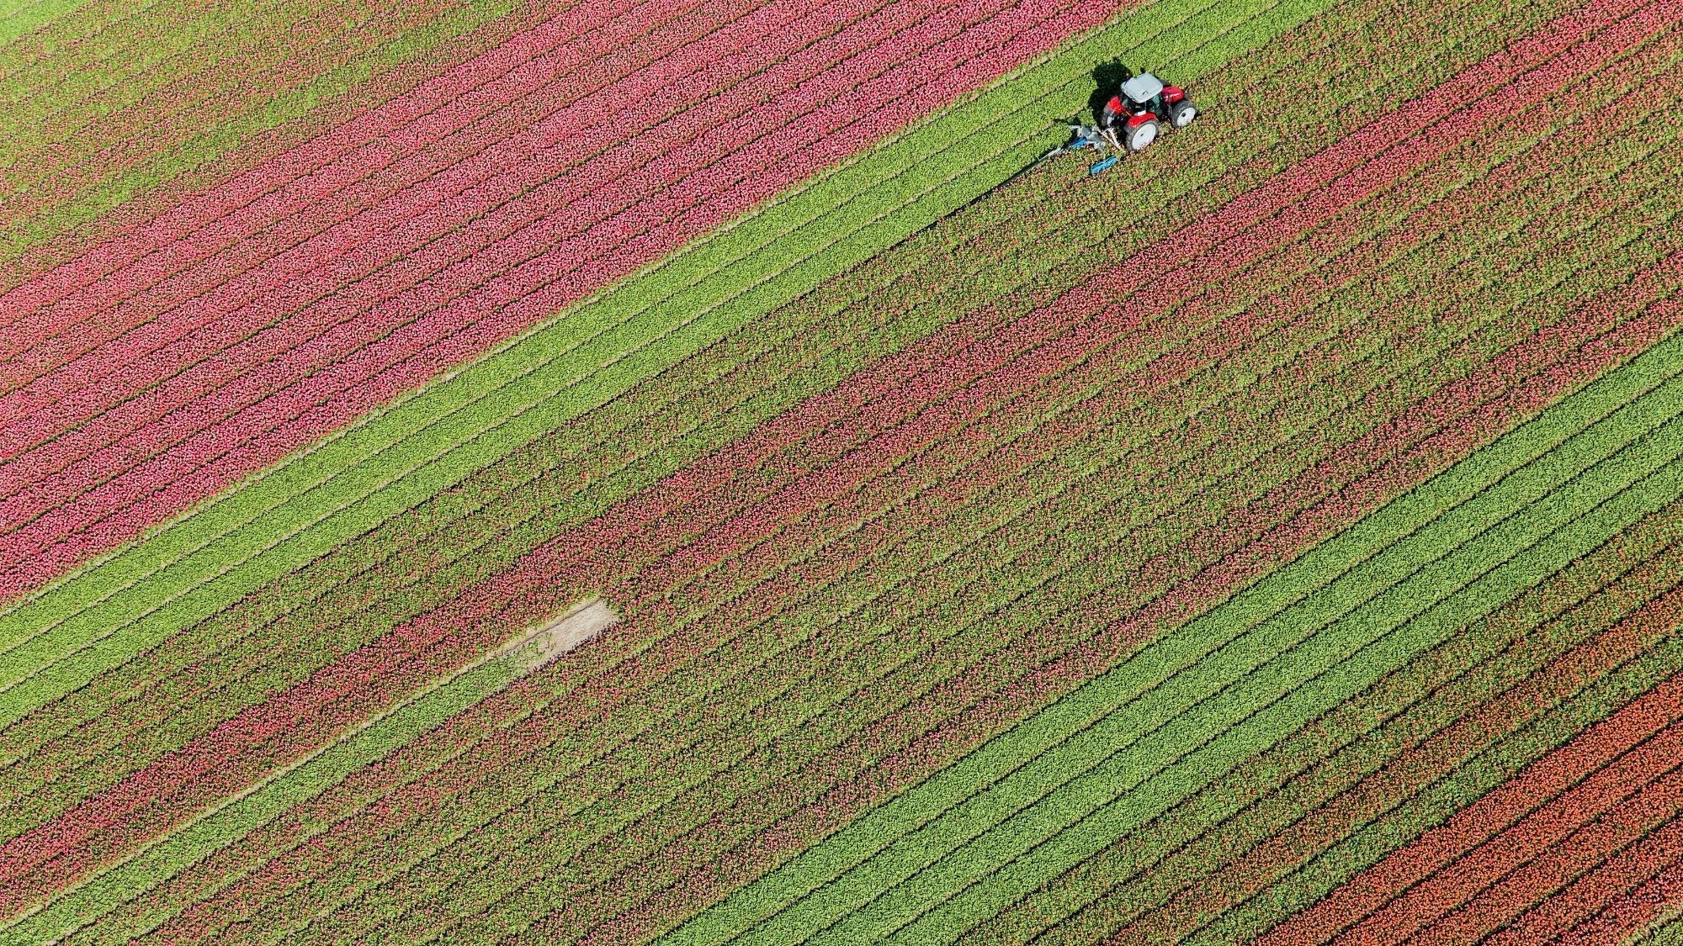
Agricultural Crop Recommendation System using Machine Learning: Recommending based on the Environmental Aspects of a Specific land
Thriloke N(210701291)
Vaishnav Kumar G(210701297) Nandha Krishna N(210701518)

Slide 2
ABSTRACT
We aim to develop machine learning models that recommend optimal crops based on soil conditions to help farmers minimize losses and maximize profits. Our system will use a dataset containing values of nitrogen, phosphorus, potassium, soil pH, temperature, and rainfall. By analyzing these parameters, we can predict the best crops for specific regions, enabling informed farming decisions.

Slide 3
EXISTING SYSTEM
The main challenge faced in agriculture sector is the lack of knowledge about the changing variations in climate. Each crop has its own suitable climatic features. This can be handled with the help of precise farming techniques. The precision farming not only maintains the productivity of crops but also increases the yield rate of production. The existing system which recommends crop yield is either hardware-based being costly to maintain, or not easily accessible. Despite many solutions that have been recently proposed, there are still open challenges in creating a user-friendly application with respect to crop recommendation.

Slide 4
PROPOSED SYSTEM
Our system tackles crop selection for farmers. It analyzes environmental factors to recommend high-yielding, profitable crops. Unlike existing solutions, ours goes beyond yield to consider profit potential. By predicting yield based on user-provided data like nitrogen, phosphorus, potassium, temperature, humidity, PH value and rainfall in mm system empowers farmers to maximize production and income, ensuring food security.

Slide 5
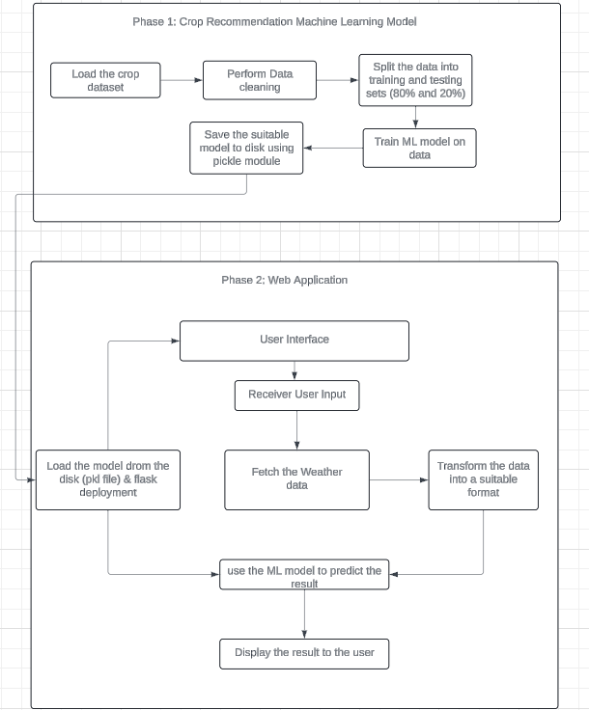
ARCHITECTURE

Slide 6
MODULES
Data Collection
Data preprocessing and Feature Extraction
Training the Random Forest Classifier
Testing the Model
Recommend Crops

Slide 7
MODULES
Data Collection: The dataset containing images of various in is collected from Kaggle. In total the dataset consist 22 different types of crops with environment aspects.
Data Preprocessing and Feature Extraction: The dataset is splitted into test and train sets. Then the data is passed to machine learning model where the machine learning model predicts the crop for recommendation system.
Training the model: The features extracted from the dataset is used to train the model.
Testing the Model: The trained model is tested using the test dataset to determine the performance of the model against unseen insect images.
Recommend Crop: Based on the user input, the model recommend suitable crop.

Slide 8
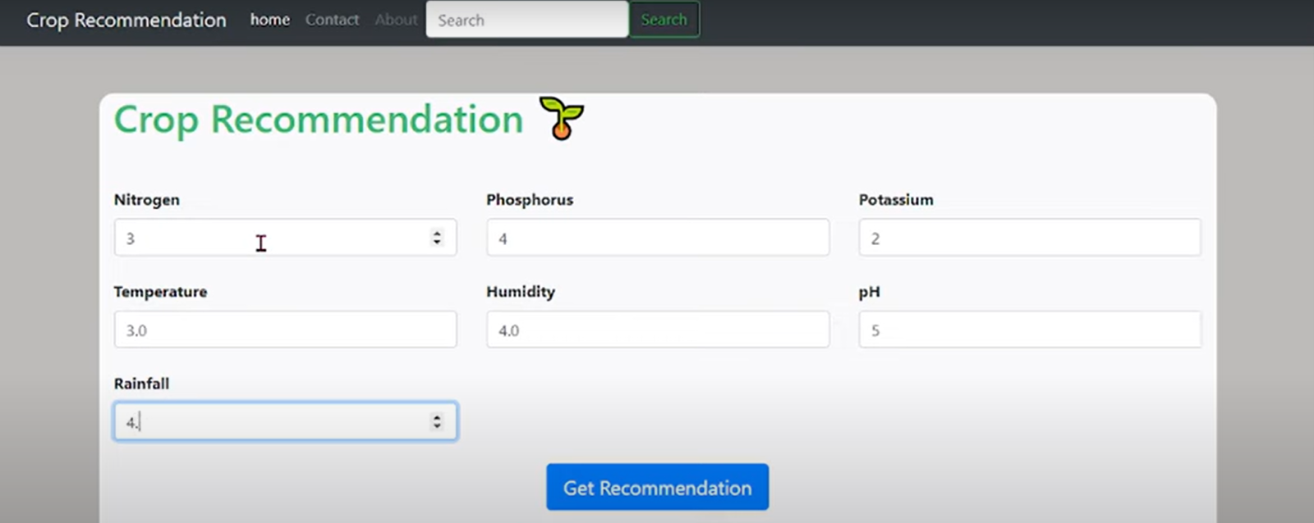
OUTPUT SCREENSHOT

Slide 9
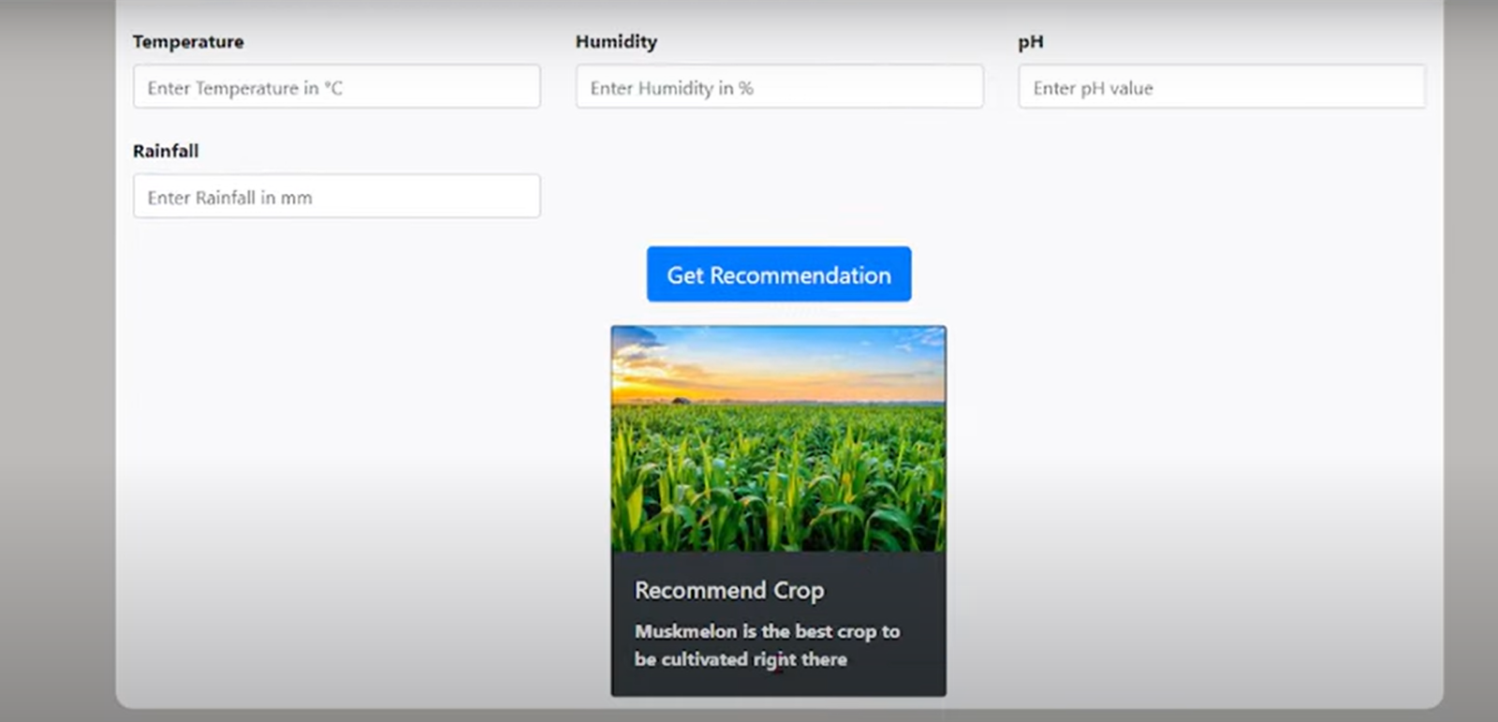
OUTPUT SCREENSHOT

Slide 10
RESULT AND DISCUSSION
The crop recommendation system website was made using HTML, CSS and JavaScript in the frontend and Flask framework in the backend. The website front end was made using the Materialize CSS framework. We have used HTML forms to capture the input data from the user. The ‘Recommend Crop’ button is a submit button that uses the HTTP POST method which sends the data to the python Flask. It takes humidity and temperature values from the user as input, then the model predicts the crop for production then, the model recommends the crop for farming to get the maximum yield , which alternatively gets maximum profit.

Slide 11
CONCLUSION
The Crop Recommendation System is mainly used to recommend the optimal crop to the Farmer. With many industries going digital, it is important that the agricultural sector also take advantage of the various technologies by using them to solve problems faced by the farmers. Using the approach that we discussed, farmers can expect greater yields. This system can be integrated with other smart agricultural systems that already exist. It is cost efficient and helps the farmers make an informed decision.

Slide 12
FUTURE ENHANCEMENTS
Enhancing the system with the market-demand products: Connect the recommendation system to database where the market-demand products and seasonal fruits to get the max profit from the yield of the recommended crop for the production.
Enhanced User Experience: Develop a mobile app for easy field access and data collection, Integrate a crop management system to provide guidance on planting, irrigation, and pest control based on the chosen crop, create a farmer community forum for knowledge sharing and peer-to-peer support.

Slide 13
Thank You

